Slide 1


Working with databases in R
June 12, 2021
11:00 am - 13:00 pm (GMT+3)

Slide 2
Agenda
Time | Duration | Activity | Responsible group/ Person
11:00 pm - 11:05 pm | 5 minutes | Participants join
11:05 pm - 11:10 pm | 5 minutes | Welcoming participants | John Mutiso
11:10 pm - 11:20 pm | 10 minutes | Introduction of the collaborating groups and organisers | John Mutiso
11:20 pm - 11:25 pm | 5 minutes | Introducing the speaker | Lucy Njoki
11:25 pm - 12:25 pm | 60 minutes | Talk | Christopher Maronga
12:25 pm - 12:55 pm | 30 minutes | Q & A | Shelmith Kariuki
13:55 pm - 13:00 pm | 5 minutes | Closing remarks | Shelmith Kariuki

Slide 3
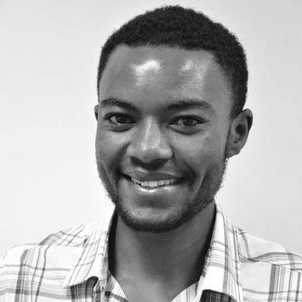
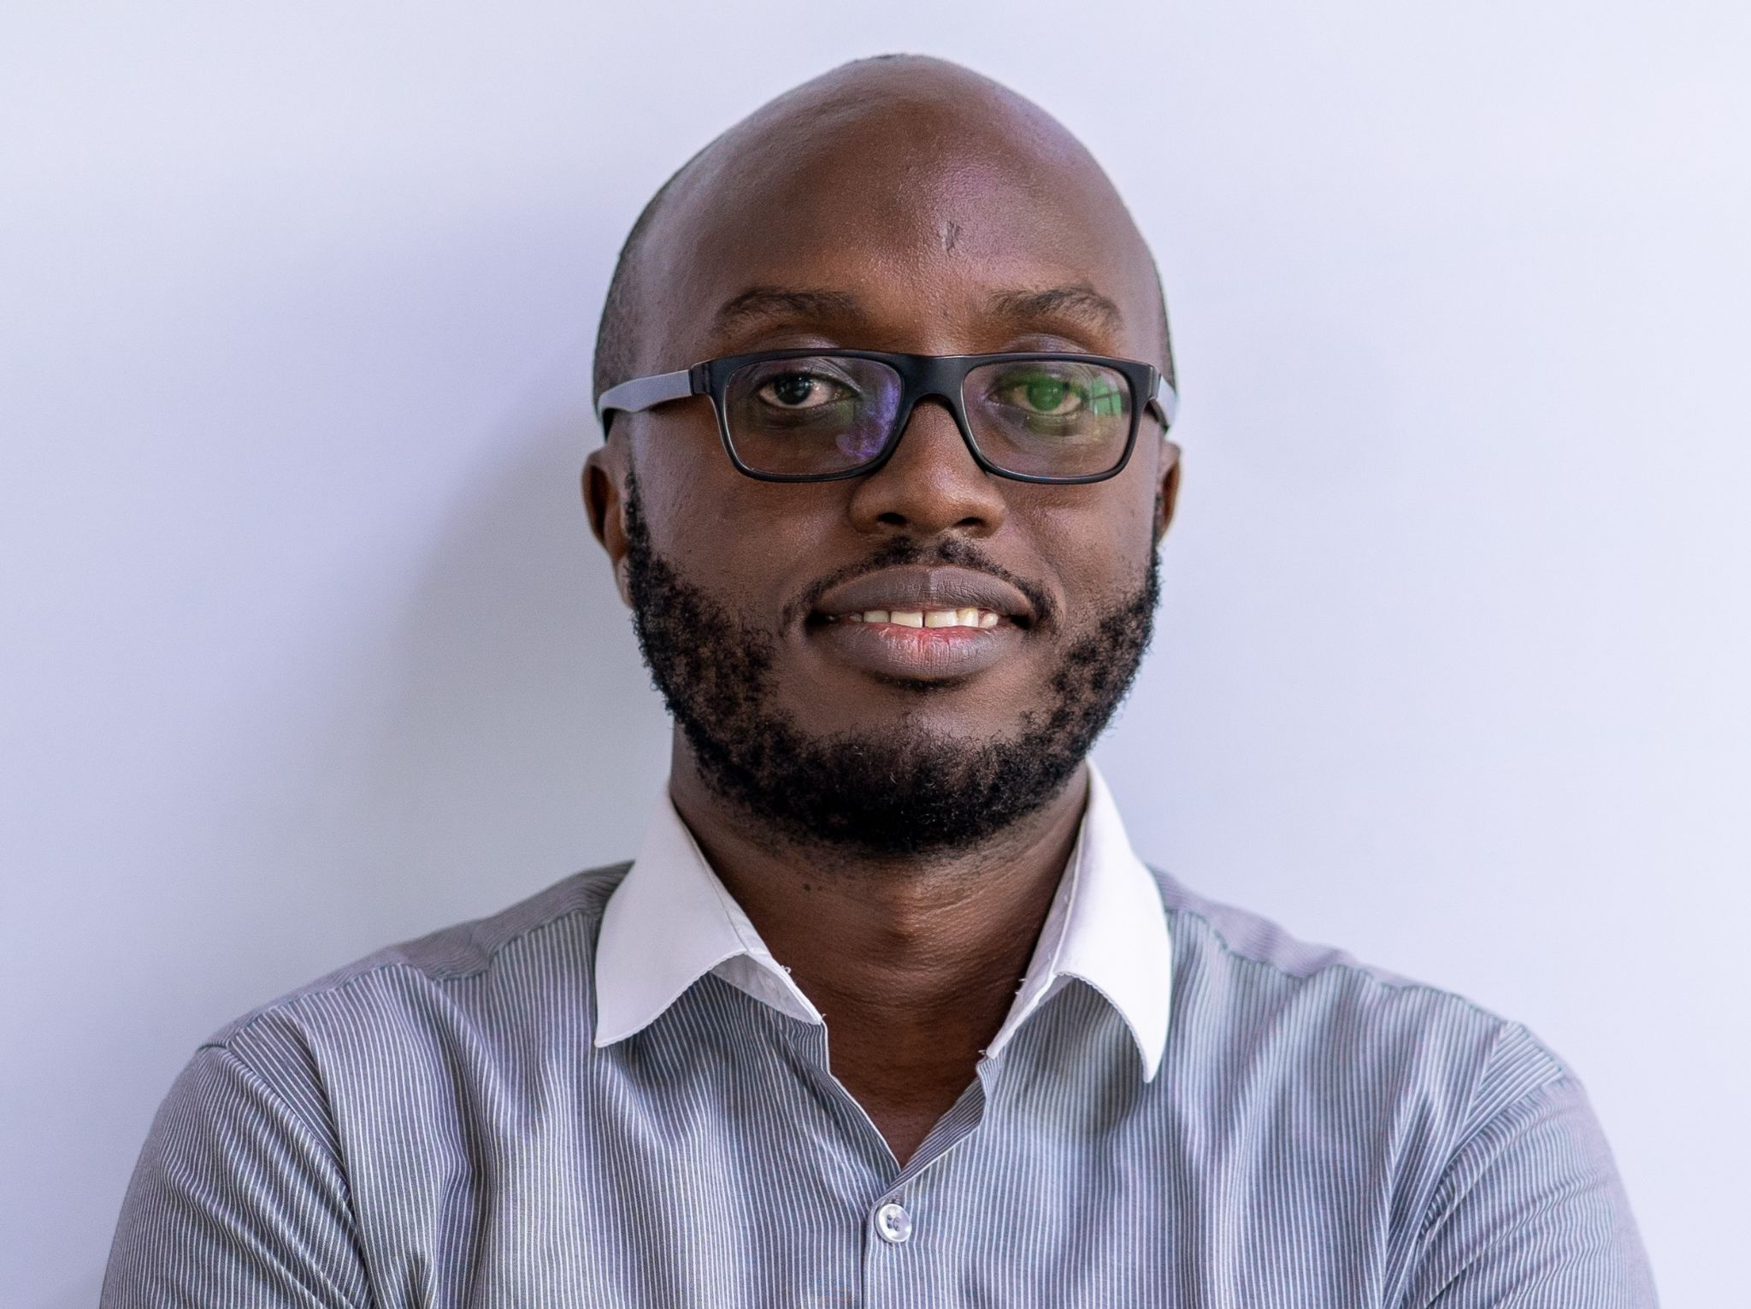
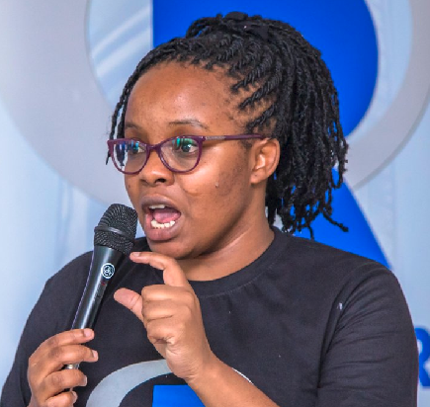
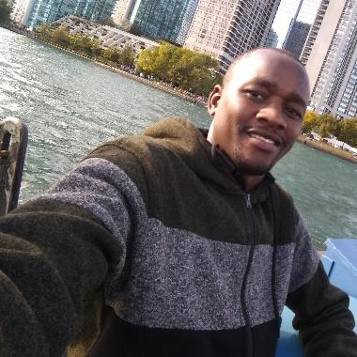
NairobiR Organizers
Christopher Maronga
John Mutiso
Kigen Tembu
Shelmith Kariuki
Data Manager
Statistical programmer
Senior Data Analyst
Senior Data Analyst

Slide 4
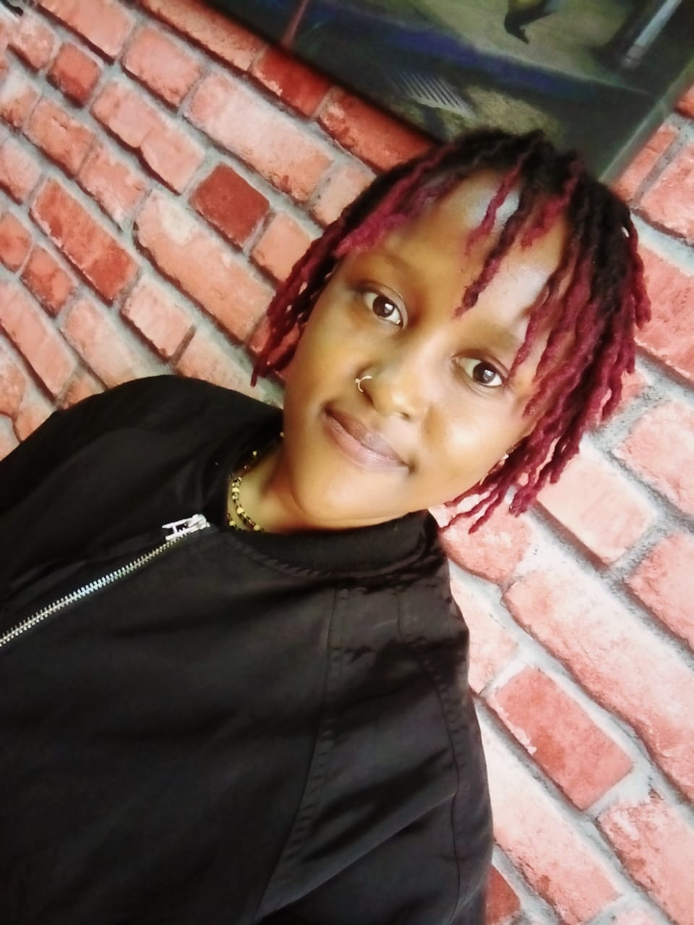
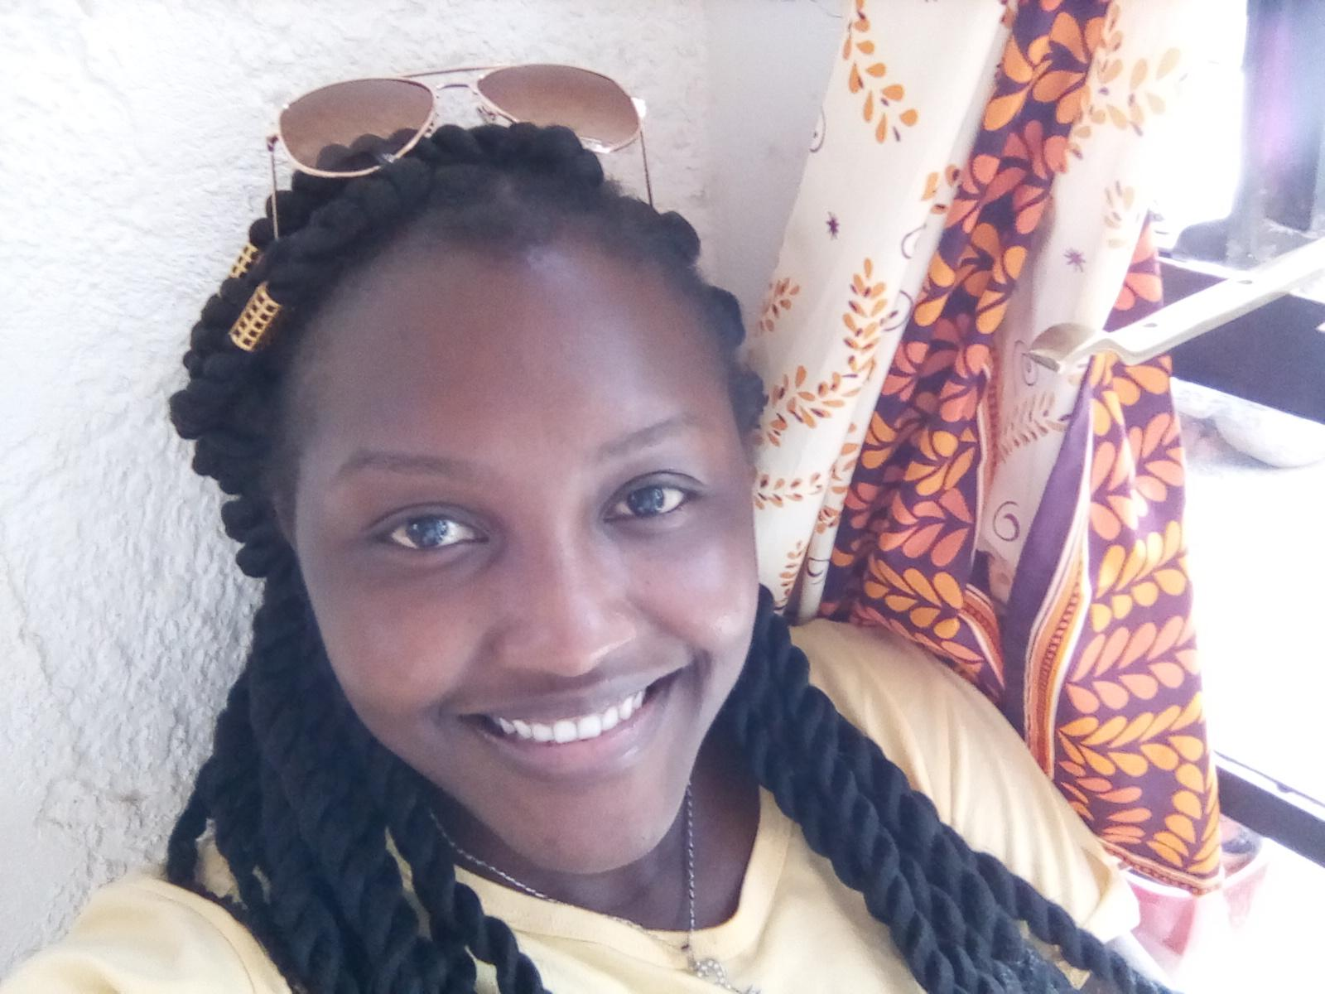
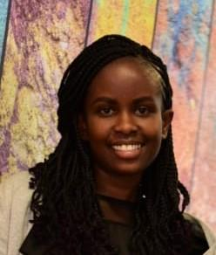
R-Ladies Nairobi Organizers
Lucy Njoki
Margaret Wanjiru
Faith Musili
Shelmith Kariuki
Biostatistician
Financial Risk Analyst
Senior Data Analyst
Senior Data Analyst

Slide 5
Our Trainer
Christopher Maronga
Data Manager (Clinical) - KEMRI-Wellcome Trust

Slide 6
Training Session

Slide 7
Q & A

Slide 8
Thank you on behalf of

